Slide 1
MUSC Boeing Center for Children’s Wellness
[Insert School Name]
School Wellness Initiative

Slide 2
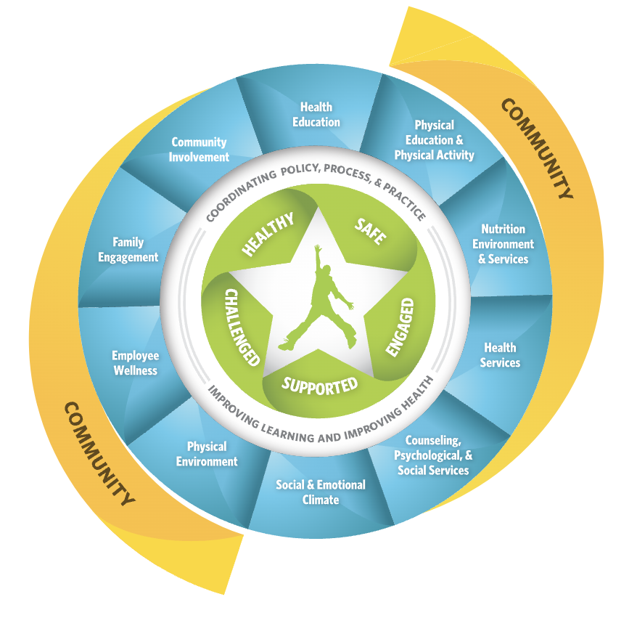
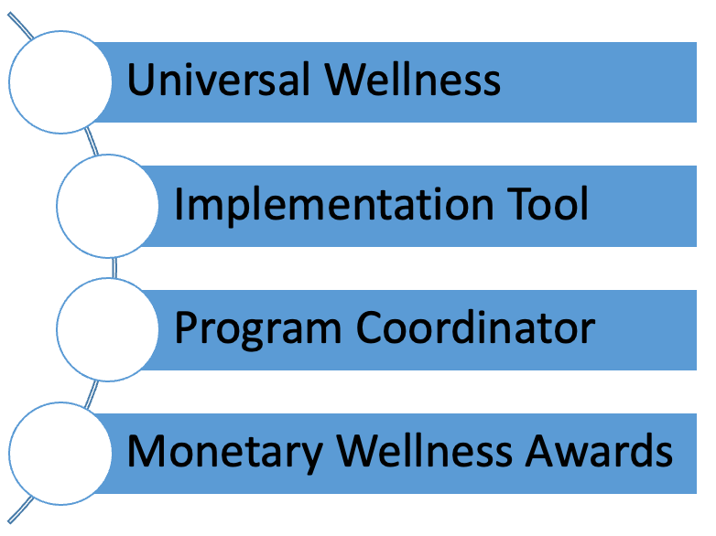
What is the School Wellness Initiative
Photo Source: CDC WSCC Model
Notes:
Learn more about the Whole School, Whole Community, Whole Child Model
https://www.cdc.gov/healthyschools/wscc/index.htm
Universal Wellness = every student and every staff member at our school. Open for ALL! (i.e. not just the PE coach and football team or select club)
Implementation Tool = School Wellness Checklist, a menu of evidence-based wellness projects

Slide 3
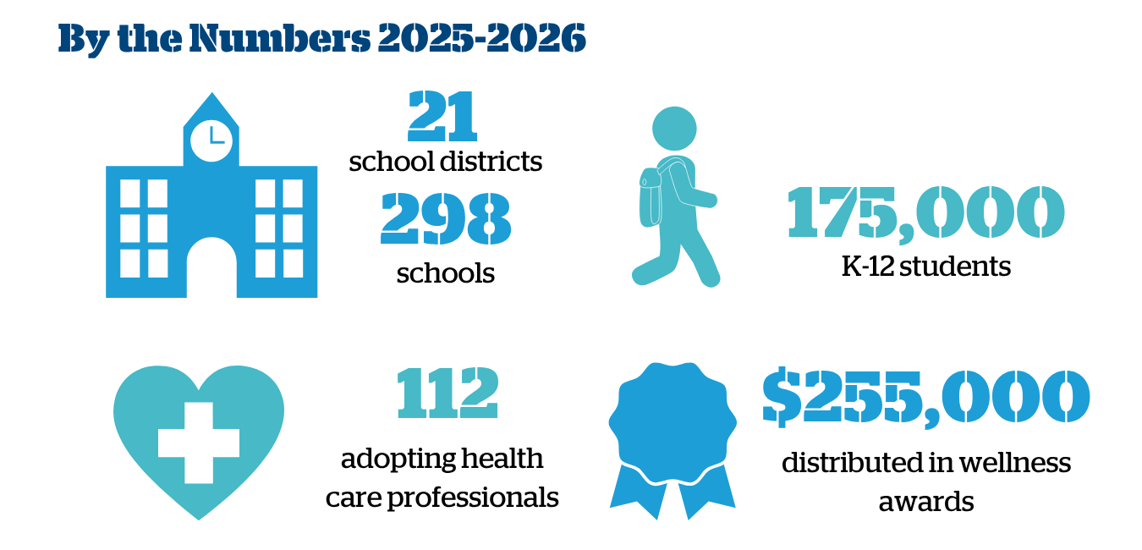
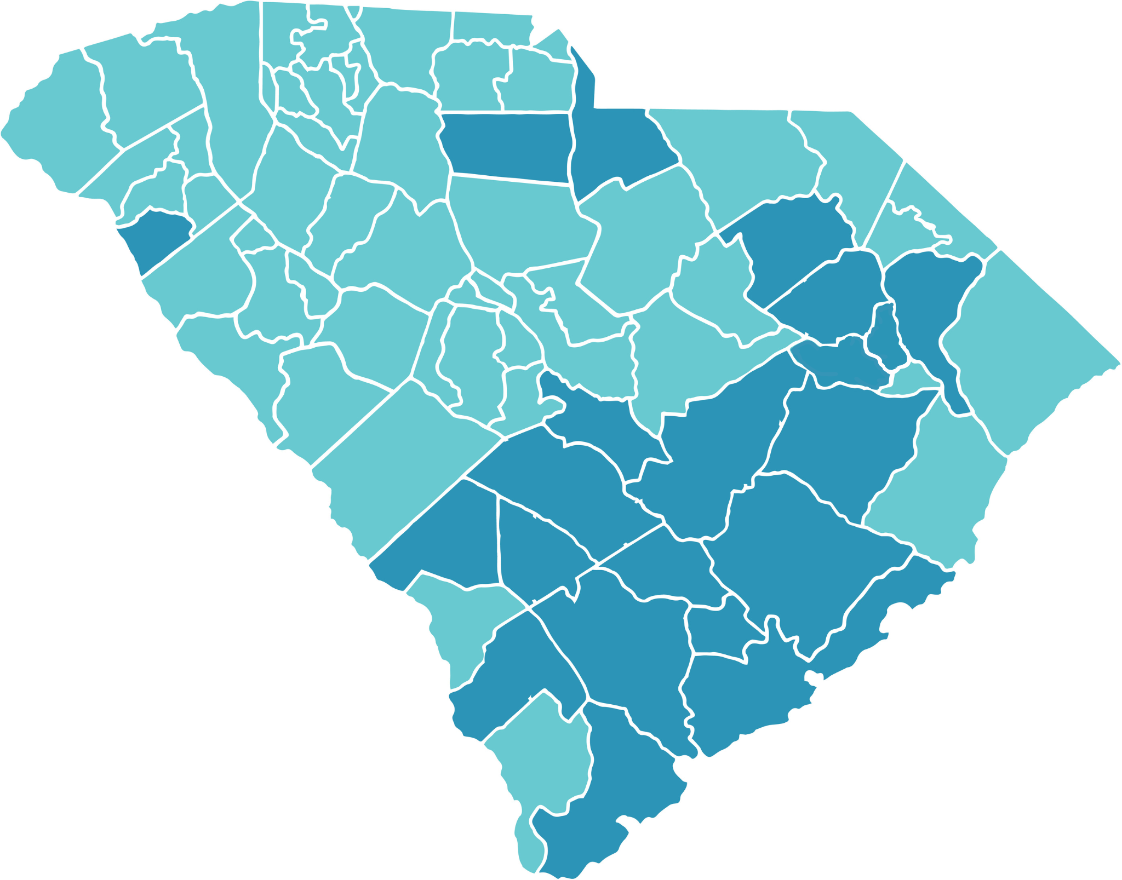
2025-2026 School Year
MUSC Boeing Center for Children’s Wellness State-wide Impact ​

Slide 4
[Insert District Name]
Email Program Coordinator for your district's specific overview
Notes:
Add for the specific district

Slide 5
How it Works
Our school has a wellness committee that meets at least 4 times a year
The committee selects wellness activities and implements wellness strategies that earns our school points each year
We must earn at least 50 points during the school year, a minimum of 1 point in each of the following categories:
  Getting Started
  Nutrition
  Physical Activity
  Social Emotional Wellness
  Wellness Culture
  Staff Wellness
  Sustainability
If we meet these requirements, we earn a wellness award! Help us earn an award and compete against all the other schools in our district for the grand prize.

Slide 6
Wellness Committee Members
Edit as Needed
Wellness Leader:
Principal:
Food Service Manager:
School Nurse:
School Mental Health Counselor:
PE Teacher:
Classroom Teacher:
School Resource Officer:
After-School Program Staff:
Parent:
Student:
Health Professional:
Other Staff Members:
Community Member:
Business or Organization Representative:
Notes:
This is our schools Wellness Committee Members

Slide 7
Award Structure

Slide 8
[Insert School’s Name]
Wellness Mission Statement
[Insert School’s Wellness Committee Mission Statement here for the 26-27 School Year.]
Notes:
Look at your archive report if you have a wellness mission statement or create one together.
Claim 1 point under Getting Started #8

Slide 9
Wellness Committee Goals
Last year we earned [Insert Point Number] points and a wellness award of $[Award Total]
Our Goals for this school year:
  [Insert Goal]
  [Insert Goal]
  [Insert Goal]
Notes:
Get points earned and total award from Archive Report 23-24 School Year.
SMART Goals, claim 3 points under Getting Started #10 by filling out this worksheet

Slide 10
How Can You Help
  Join the wellness committee, our next meeting is [insert meeting date]
  Participate in the wellness activities selected by the wellness committee
  Add wellness activities in your classroom. Then tell [Wellness Lead], our schools Wellness Lead, so we can earn the points for your efforts
Notes:
- Have the School Wellness Checklist available to hand out

